Slide 1
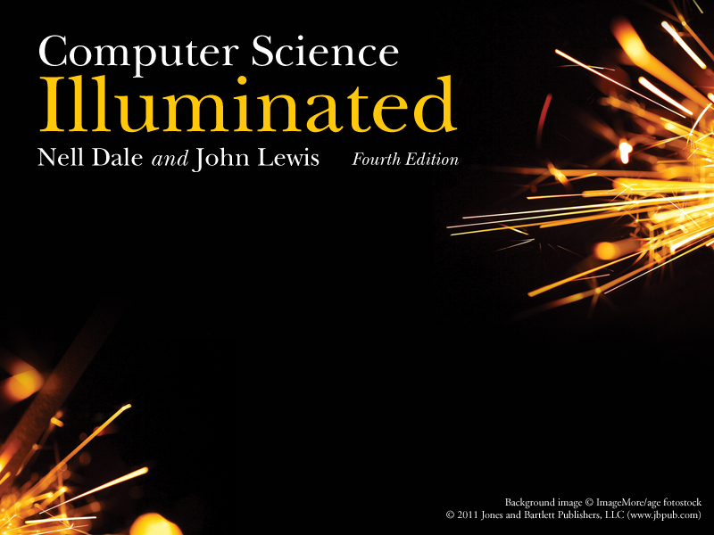
Chapter 2
Binary Values and Number Systems

Slide 2
Chapter Goals
Distinguish among categories of numbers
Describe positional notation
Convert numbers in other bases to base 10
Convert base-10 numbers to numbers in other bases
Describe the relationship between bases 2, 8, and 16
Explain the importance to computing of bases that are powers of 2
24
6

Slide 3
Numbers
Natural Numbers
Zero and any number obtained by repeatedly adding one to it.
Examples: 100, 0, 45645, 32
Negative Numbers
A value less than 0, with a – sign
Examples: -24, -1, -45645, -32
2

Slide 4
Numbers
Integers
A natural number, a negative number, zero
Examples: 249, 0, - 45645, - 32
Rational Numbers
An integer or the quotient(商數) of two integers
Examples: -249, -1, 0, 3/7, -2/5
3

Slide 5
Natural Numbers
How many ones are there in 642?
600 + 40 + 2 ?
Or is it
384 + 32 + 2 ?
Or maybe…
1536 + 64 + 2 ?
4

Slide 6
Natural Numbers
Aha!
642 is 600 + 40 + 2 in BASE 10
The base of a number determines the number of digits and the value of digit positions
5

Slide 7
Positional Notation
Continuing with our example…
642 in base 10 positional notation is:
6 x 10² = 6 x 100 = 600
+ 4 x 10¹ = 4 x 10 = 40
+ 2 x 10º = 2 x 1 = 2 = 642 in base 10
The power(指數) indicates
the position of
the number
This number is in
base 10
6

Slide 8
Positional Notation
R is the base
of the number
As a formula:
d_{n} * R^{n-1} + d_{n-1} * R^{n-2} + ... + d₂ * R + d₁
n is the number of
digits in the number
d is the digit in the
i^{th} position
in the number
642 is 6 * 10² + 4 * 10 ⁺ 2
7

Slide 9
Positional Notation
What if 642 has the base of 16?
642 in base 16 is equivalent to 1602 in base 10
+ 6 x 16² = 6 x 256 = 1536
+ 4 x 16¹ = 4 x 16 = 64
+ 2 x 16º = 2 x 1 = 2
= 1602 in base 10
6
8

Slide 10
Converting Octal to Decimal
What is the decimal equivalent of the octal number 642?
6 x 8² = 6 x 64 = 384
+ 4 x 8¹ = 4 x 8 = 32
+ 2 x 8º = 2 x 1 = 2
= 418 in base 10
11

Slide 11
Bases Higher than 10
How are digits in bases higher than 10 represented?
With distinct symbols for 10 and above.
Base 16 has 16 digits:
0,1,2,3,4,5,6,7,8,9,
A(10),B(11),C(12),D(13),E(14), and F(15)
10

Slide 12
Converting Hexadecimal to Decimal
What is the decimal equivalent of the hexadecimal number DEF?
D x 16² = 13 x 256 = 3328
+ E x 16¹ = 14 x 16 = 224
+ F x 16º = 15 x 1 = 15
= 3567 in base 10
Remember, the digits in base 16 are 0,1,2,3,4,5,6,7,8,9,A,B,C,D,E,F

Slide 13
Binary
Decimal is base 10 and has 10 digits: 0,1,2,3,4,5,6,7,8,9
Binary is base 2 and has 2 digits:
0,1
For a number to exist in a given base, it can only contain the digits in that base, which range from 0 up to (but not including) the base.
What bases can these numbers be in? 122, 198, 178
9

Slide 14
Converting Binary to Decimal
What is the decimal equivalent of the binary number 1101110?
1 x 2⁶ = 1 x 64 = 64
+ 1 x 2⁵ = 1 x 32 = 32
+ 0 x 2⁴ = 0 x 16 = 0
+ 1 x 2³ = 1 x 8 = 8
+ 1 x 2² = 1 x 4 = 4
+ 1 x 2¹ = 1 x 2 = 2
+ 0 x 2º = 0 x 1 = 0
= 110 in base 10
13

Slide 15
Arithmetic in Binary
Remember that there are only 2 digits in binary, 0 and 1
1 + 1 is 0 with a carry
Carry Values
0 1 1 1 1 1
1 0 1 0 1 1 1
+1 0 0 1 0 1 1
1 0 1 0 0 0 1 0
14

Slide 16
Subtracting Binary Numbers
Remember borrowing? Apply that concept here:
1 2
2 0 2
1 0 1 0 1 1 1
- 1 1 1 0 1 1
0 0 1 1 1 0 0
15

Slide 17
Counting in Binary/Octal/Decimal
Binary Decimal Hexadecimal Octal
0000 0 0 0
0001 1 1 1
0010 2 2 2
0011 3 3 3
0100 4 4 4
0101 5 5 5
0110 6 6 6
0111 7 7 7
1000 8 8 10
1001 9 9 11
1010 10 A 12
1011 11 B 13
1100 12 C 14
1101 13 D 15
1110 14 E 16
1111 15 F 17

Slide 18
Converting Binary to Octal
Mark groups of three (from right)
Convert each group
10101011 10 101 011
2 5 3
10101011 is 253 in base 8
17

Slide 19
Converting Binary to Hexadecimal
Mark groups of four (from right)
Convert each group
10101011 1010 1011
A B
10101011 is AB in base 16
18

Slide 20
Converting Decimal to Octal
Try some!
http://fclass.vaniercollege.qc.ca/web/mathematics/real/Calculators/BaseConv_calc_1.htm

Slide 21
Converting Decimal to Other Bases
Algorithm for converting number in base 10 to other bases
While (the quotient is not zero)
  Divide the decimal number by the new base
  Make the remainder the next digit to the left in the answer
  Replace the original decimal number with the quotient
19

Slide 22
Converting Decimal to Octal
What is 1988 (base 10) in base 8?
Try it!

Slide 23
Converting Decimal to Octal
248 31 3 0
8 1988 8 248 8 31 8 3
16 24 24 0
38 08 7 3
32 8
68 0
64
4
Answer is : 3 7 0 4

Slide 24
Converting Decimal to Hexadecimal
What is 3567 (base 10) in base 16?
Try it!
20

Slide 25
Converting Decimal to Hexadecimal
222 13 0
16 3567 16 222 16 13
32 16 0
36 62 13
32 48
47 14
32
15
D E F
21

Slide 26
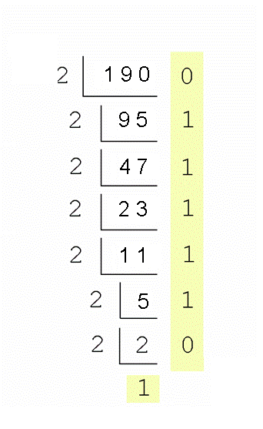
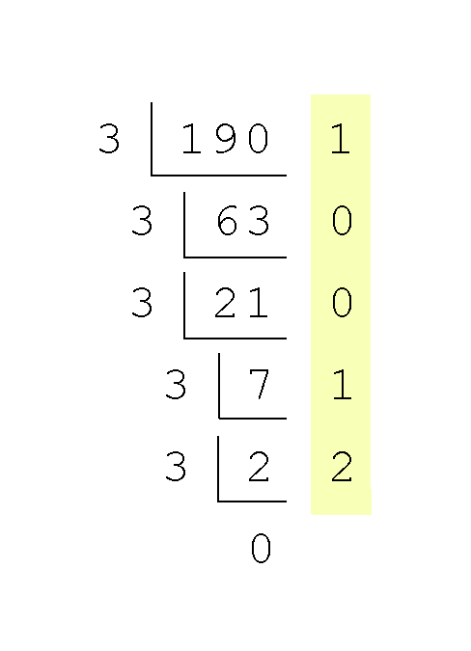
Converting Decimal to Binary
Supplement
Converting 190 to base 2
  In this case, 2 divides 190 95 times, with a remainder of 0.
  Record the quotient and the remainder.
  Continue in this way until the quotient is 1.
  Our result, reading from bottom to top is:
  190₁₀ = 10111110₂

Slide 27
Binary Numbers and Computers
Computers have storage units called binary digits or bits(位元)
Low Voltage = 0
High Voltage = 1 all bits have 0 or 1
22

Slide 28
Binary and Computers
Byte (位元組)
8 bits
The number of bits in a word(字組) determines the word length of the computer, but it is usually a multiple of 8
  32-bit machines
  64-bit machines etc.
23

Slide 29
Ethical Issues
Homeland Security (國家安全)and Carnivore/DCS-1000
What was Carnivore?
Carnivore是由美國聯邦調查局開發的程式，用來監視犯罪嫌疑人的網
路/電子郵件活動
Against whom was Carnivore to be used?
Against whom was it used?
Does security out weigh privacy(隱私) ?

Slide 30
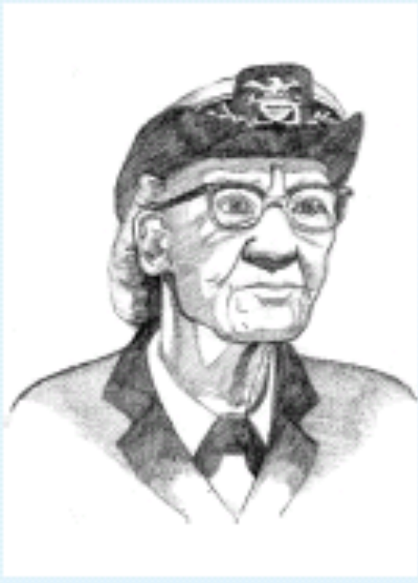
Who am I?
Can you tell the
person sitting
next to you three
things about me?

Slide 31

Do you know?
What concept makes positional notation
possible?
What three sets can children identify? What
words represent the third set?
How does an abacus work?
How does bi-quinary work?

